Slide 1

HOW TO MAKE TECHNICAL DECISIONS?

Slide 2


HOW TO MAKE TECHNICAL DECISIONS?
Oresztesz Margaritisz
Kraków, 9-11 May 2018

Slide 3
Examples
Docker swarm
Kubernetes
MongoDB
MySQL
Maven
Gradle
implement
reuse
Notes:
TODO: Under 1 minutes

Slide 4
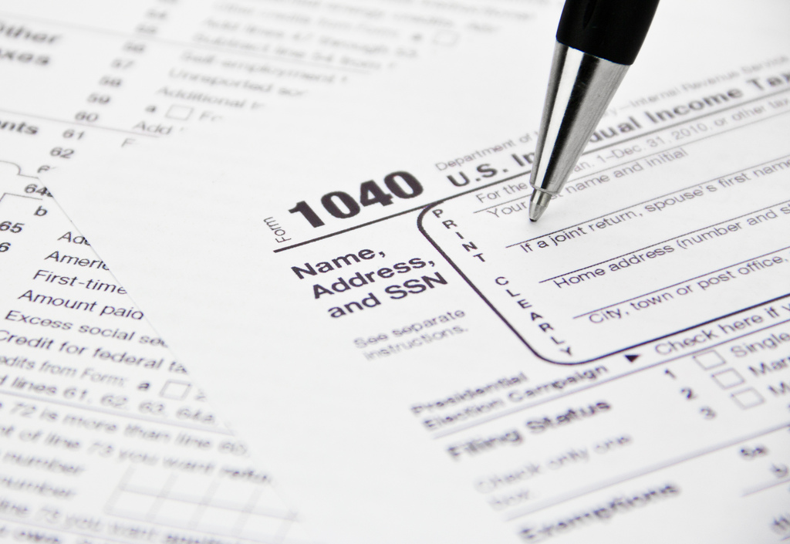
your WORST technical decision here

Slide 5
… let me help
own persistency layer
in PHP
2
non-compatible components
~ 300 dependencies each

Slide 6

We all have war stories
implement own
framework
&
use it

Slide 7
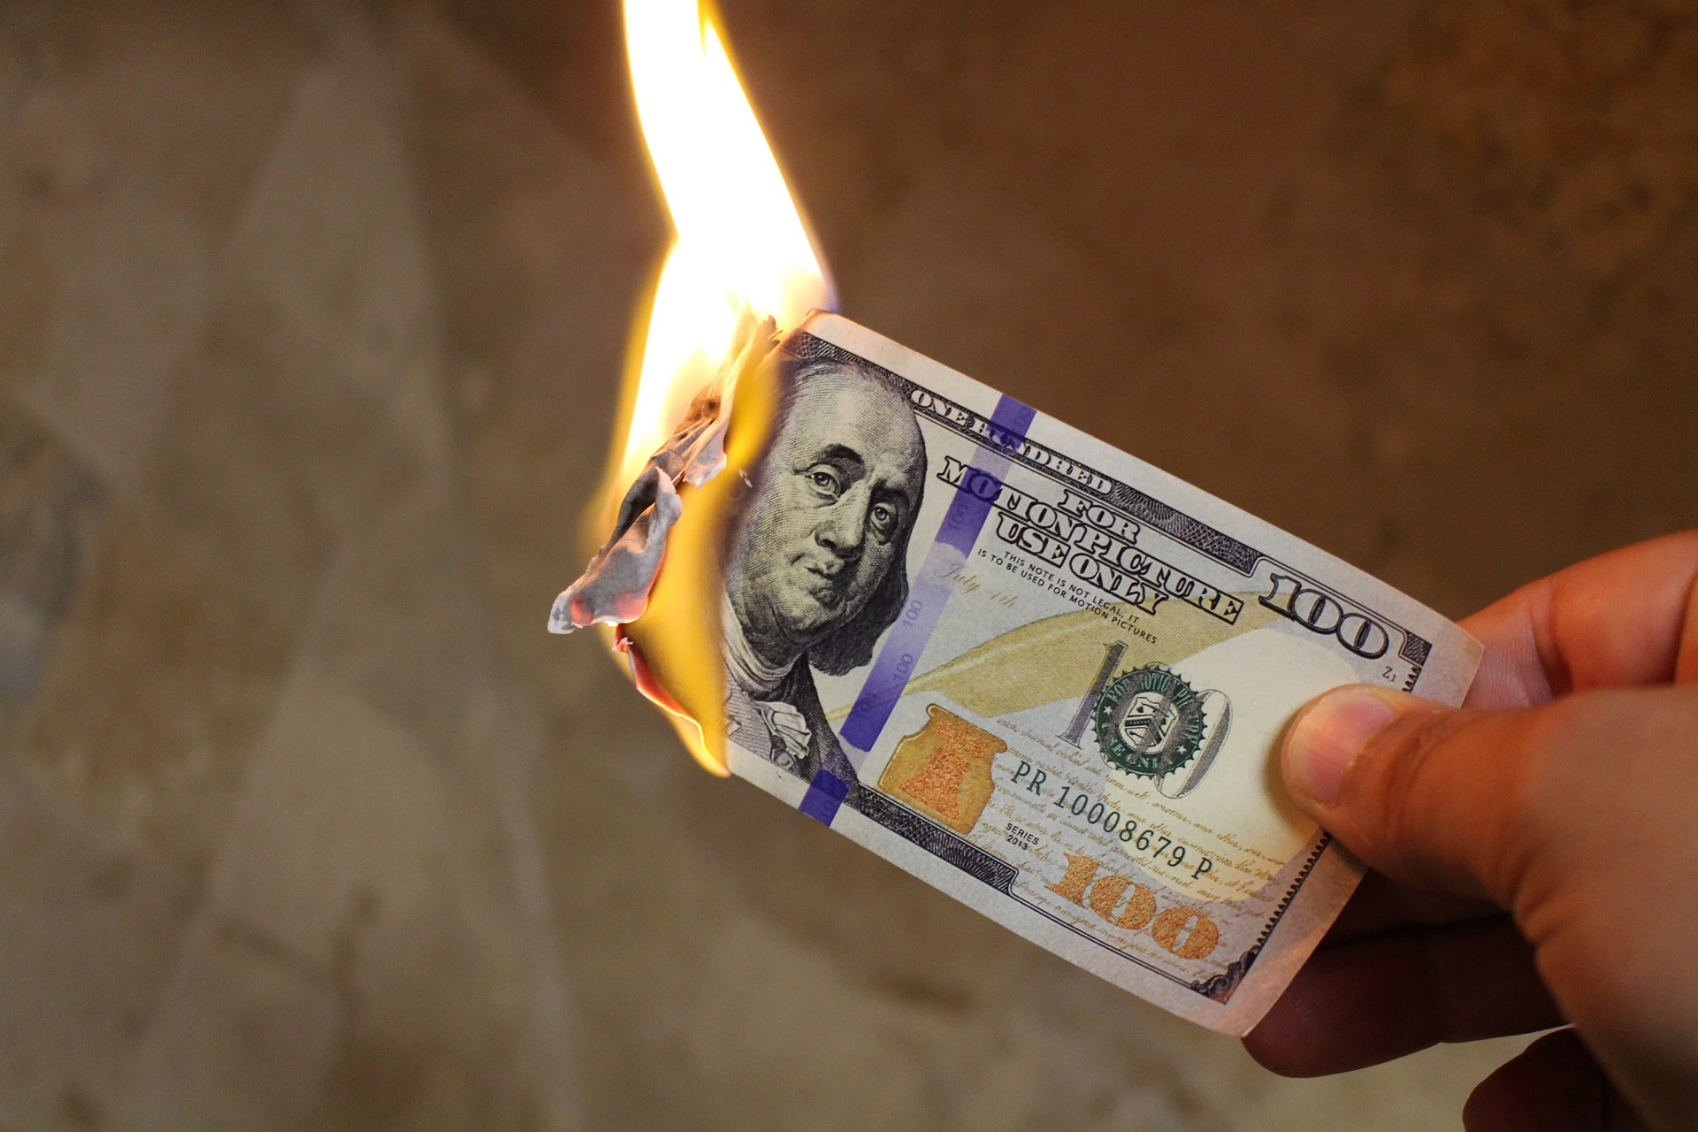
Notes:
COST OF A BAD DECISION

Slide 8




STICKY
COGNITIVE NOISE
TECHNICAL DEBT
ACCIDENTAL COMPLEXITY
Notes:
Cognitive Noise OWN STORY: 3 syntactic sugar libraries for same purpose (commons, guava)
TODO: 1:30
(PAUSE)

Slide 9


Slide 10

SOLVES THE RIGHT PROBLEM

Slide 11
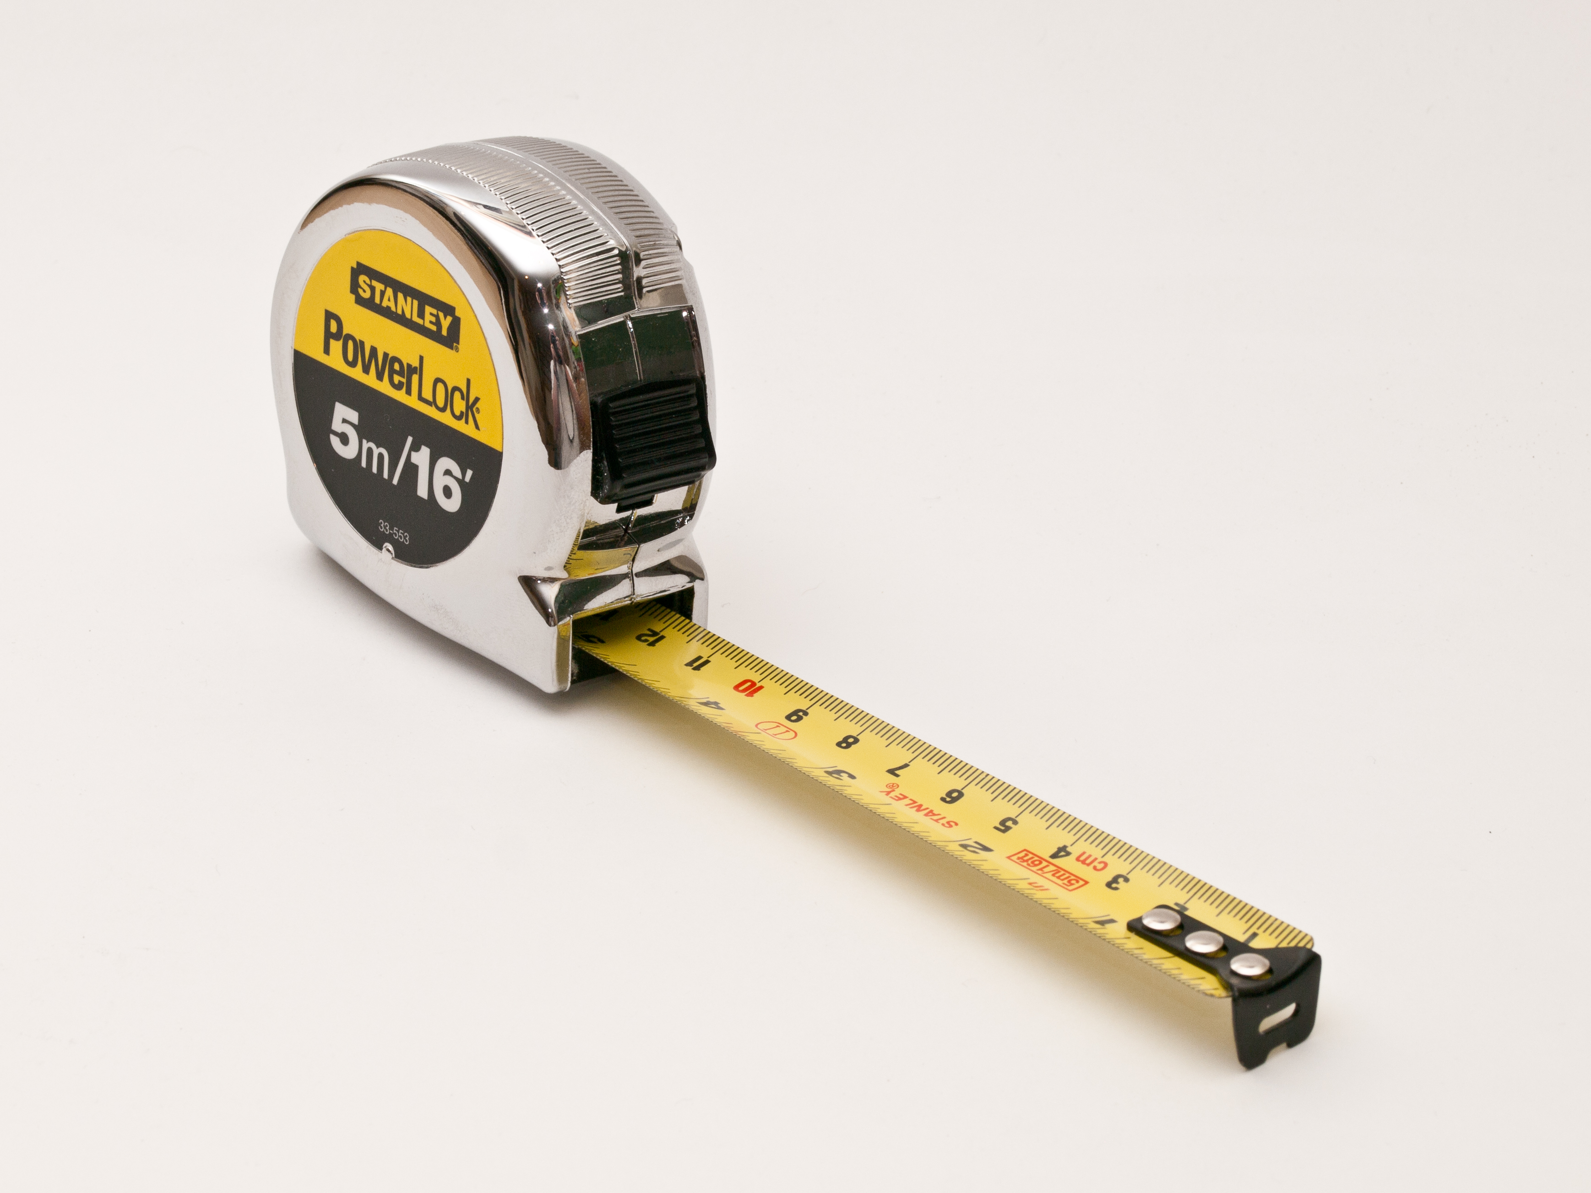
METRICS
Notes:
POLL!!!

Slide 12
What metrics would you use to aid your technical decisions? (11)
Roi
Class fan out compl.
time
What's the effort (dev-tim) required to revert it or use something else
Number of pros vs cons, feedback from communities/ppl.
Tech debts introduced (in days) / time to implement
added transitive dependencies
Size of community supporting that stuff
number of successful projects using the same technology
Commit rate
Maturity
Performance degradation
NPath complexity

Slide 13




EASY TO USE
MAINTAINABLE
FAST
NO SURPRISES

Slide 14
Learning
Curve
Design
Support
Runtime

Slide 15
API
maturity
Design
simplicity
feature
richness
interfacing
(replaceable)

Slide 16
quality
docs
usability
Learning
Curve
fast feedback
team expertise

Slide 17
technical constraints
no SPOF
performance
Runtime
stability
security

Slide 18
debugging
logging
exceptions
monitoring
Support
testing
no snowflakes

Slide 19
API
maturity
quality
docs
usability
Design
technical constraints
simplicity
Learning
Curve
interfacing
(replaceable)
feature
richness
fast feedback
team expertise
logging
debugging
stability
monitoring
exceptions
Runtime
no SPOF
Support
performance
testing
security
no snowflakes

Slide 20
HOW TO MEASURE?

Slide 21
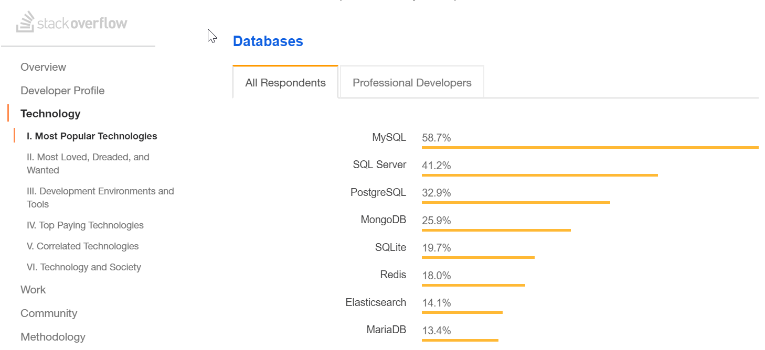
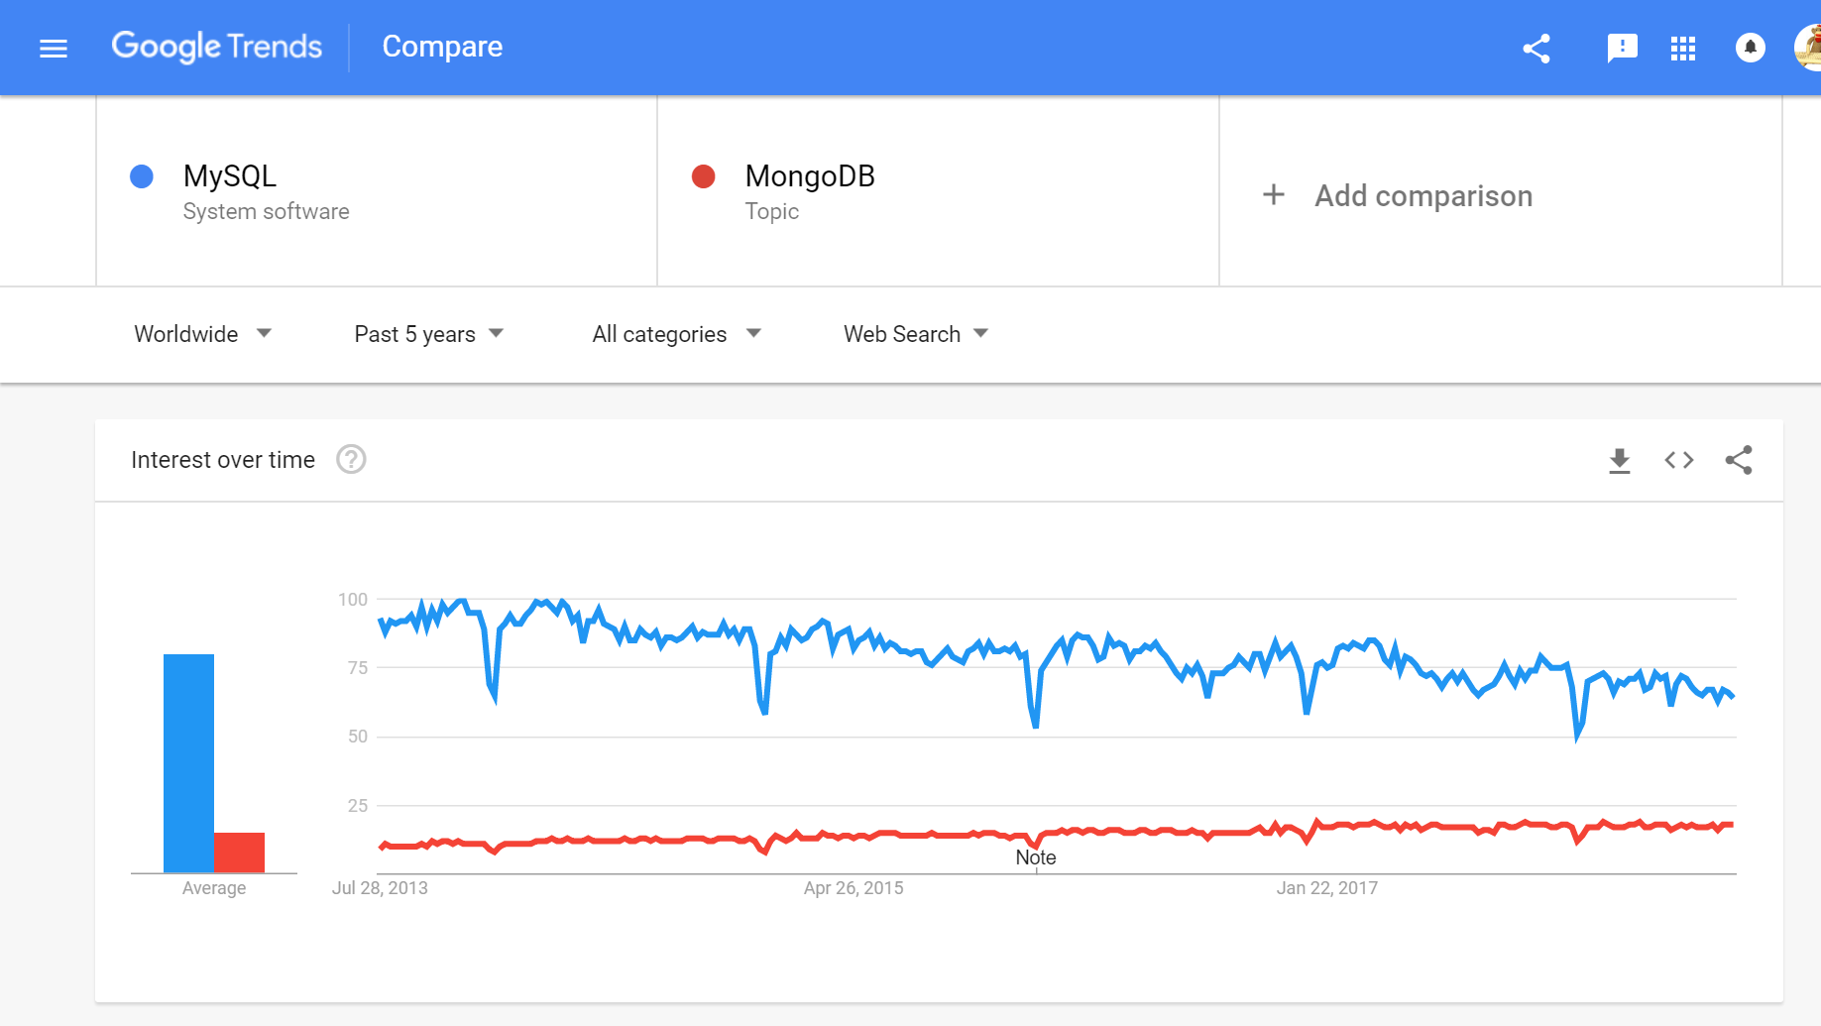
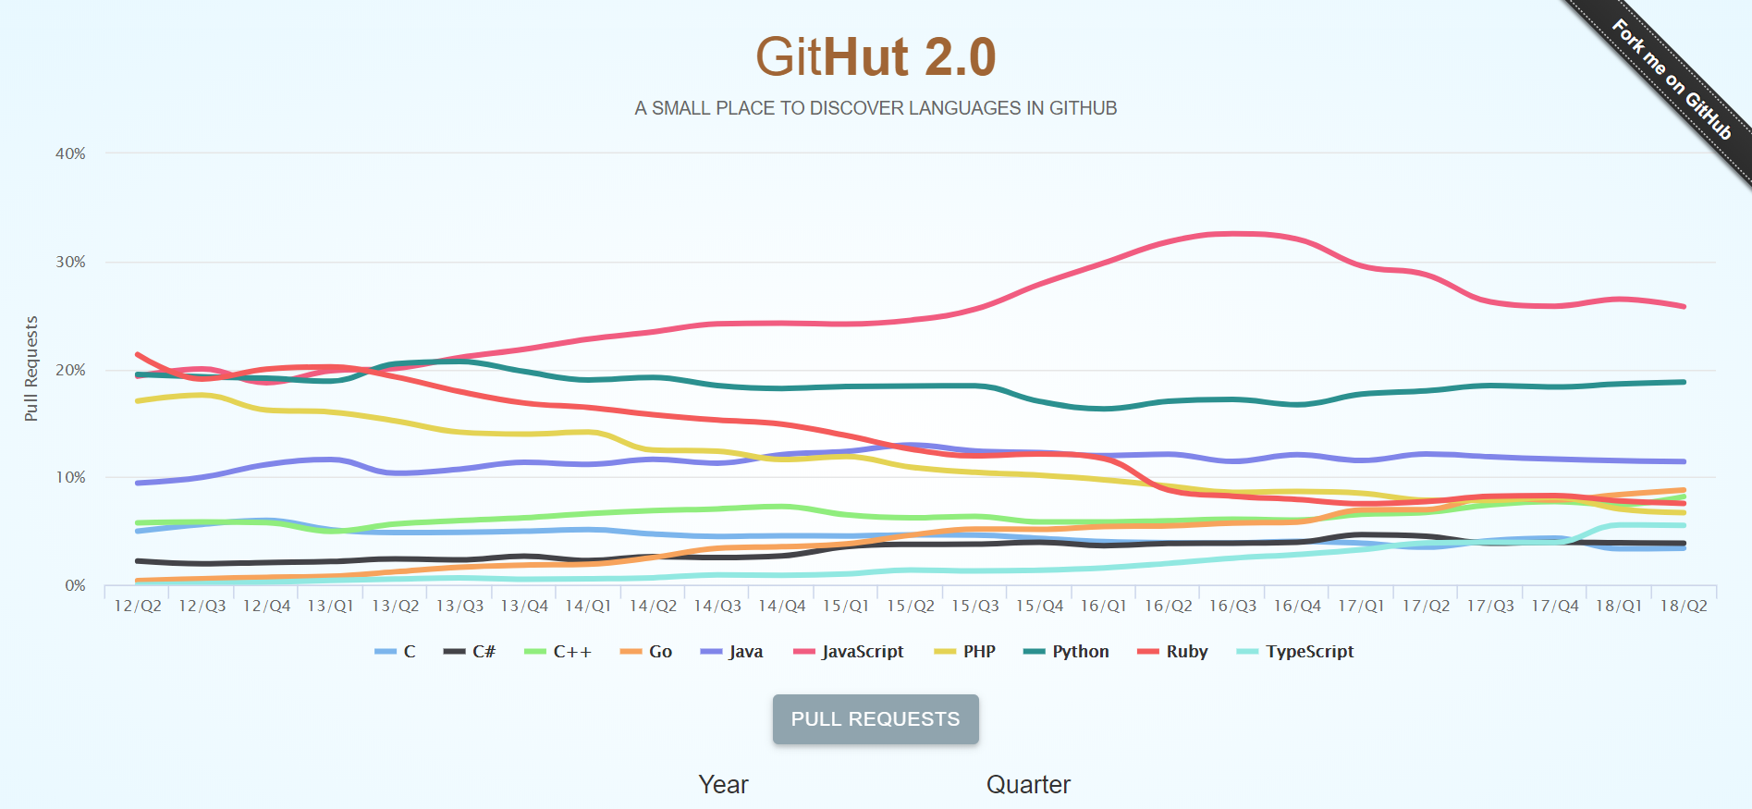
Maturity
Notes:
“how to position your technology stack in the given job market”

Slide 22

Technical Constraints & Feature Richness

Slide 23
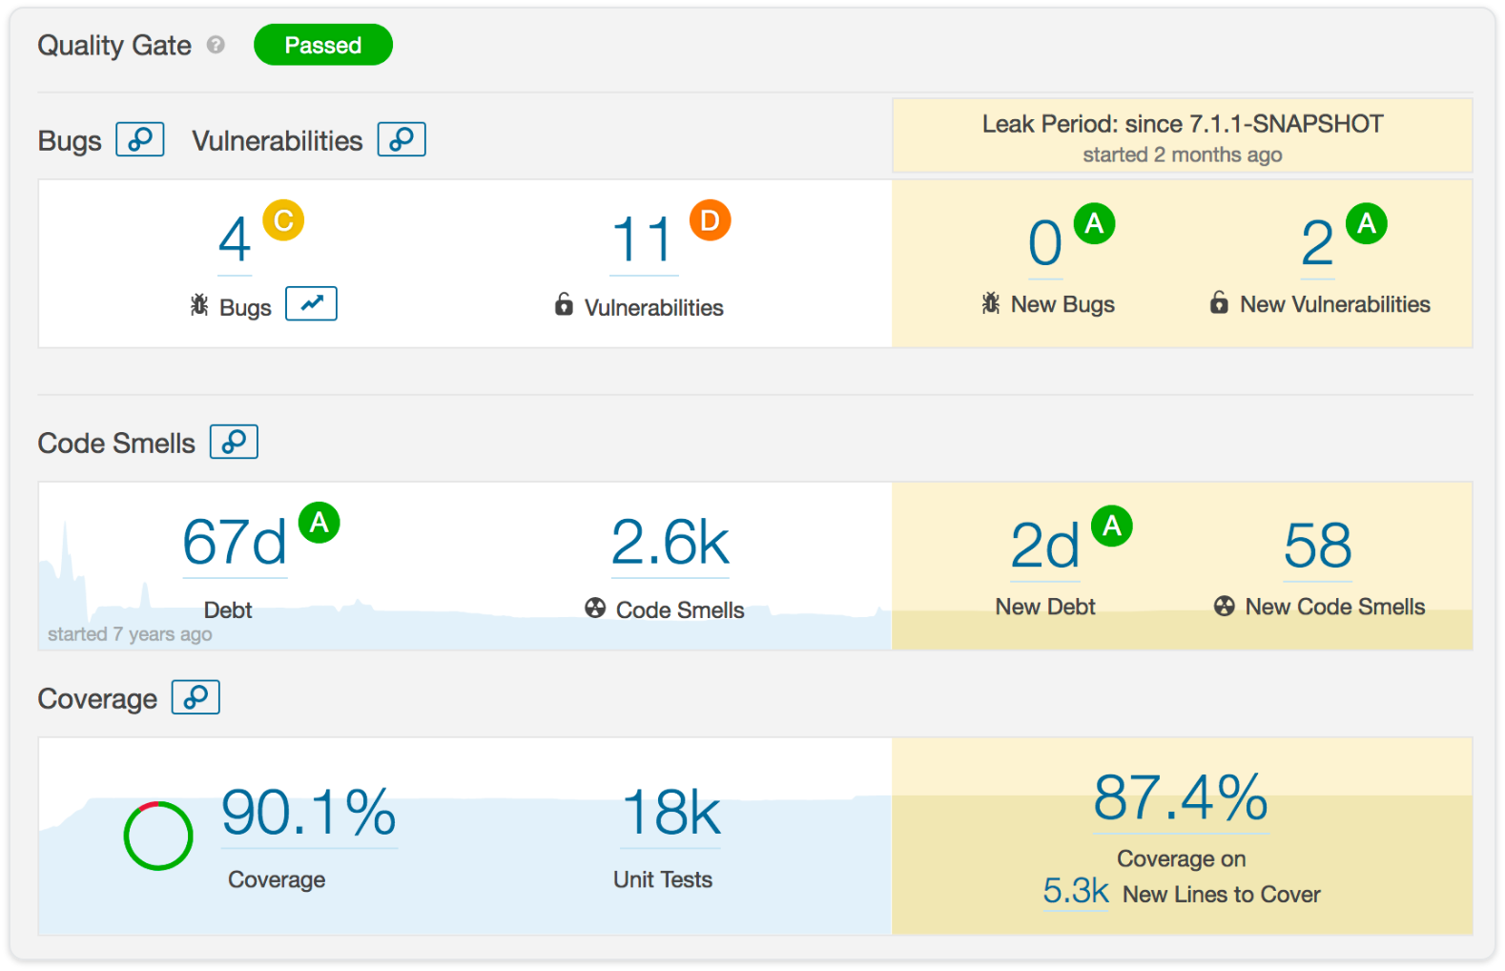
Design & Simplicity & API & Stability

Slide 24
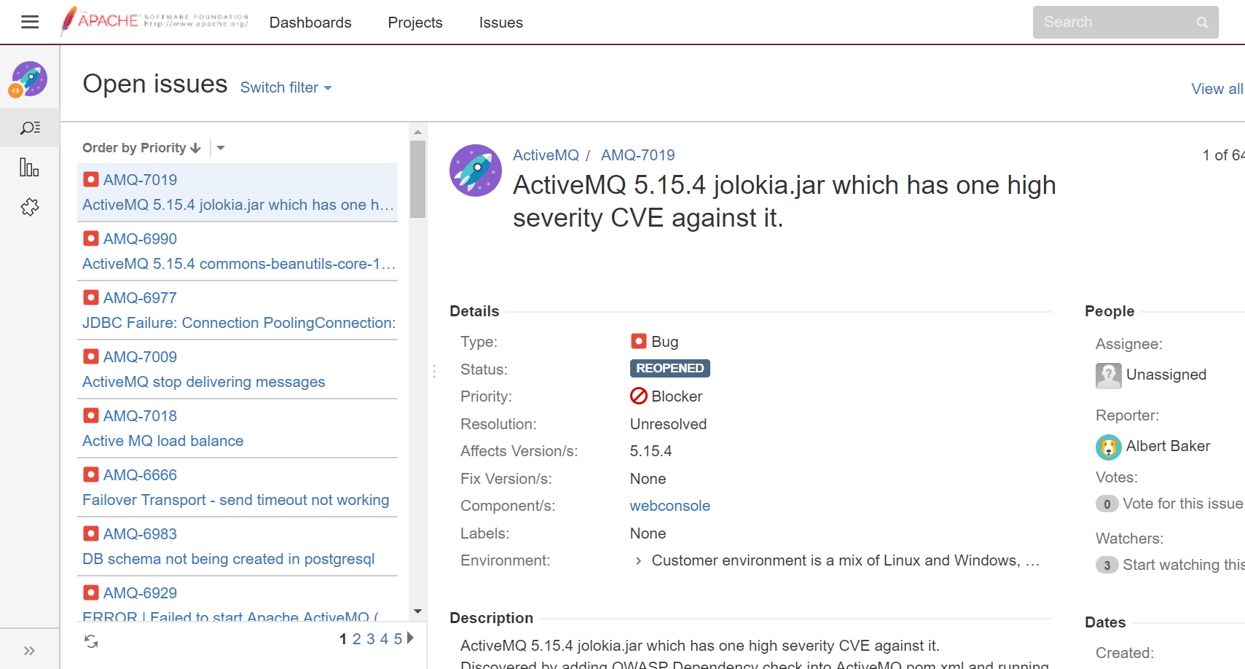
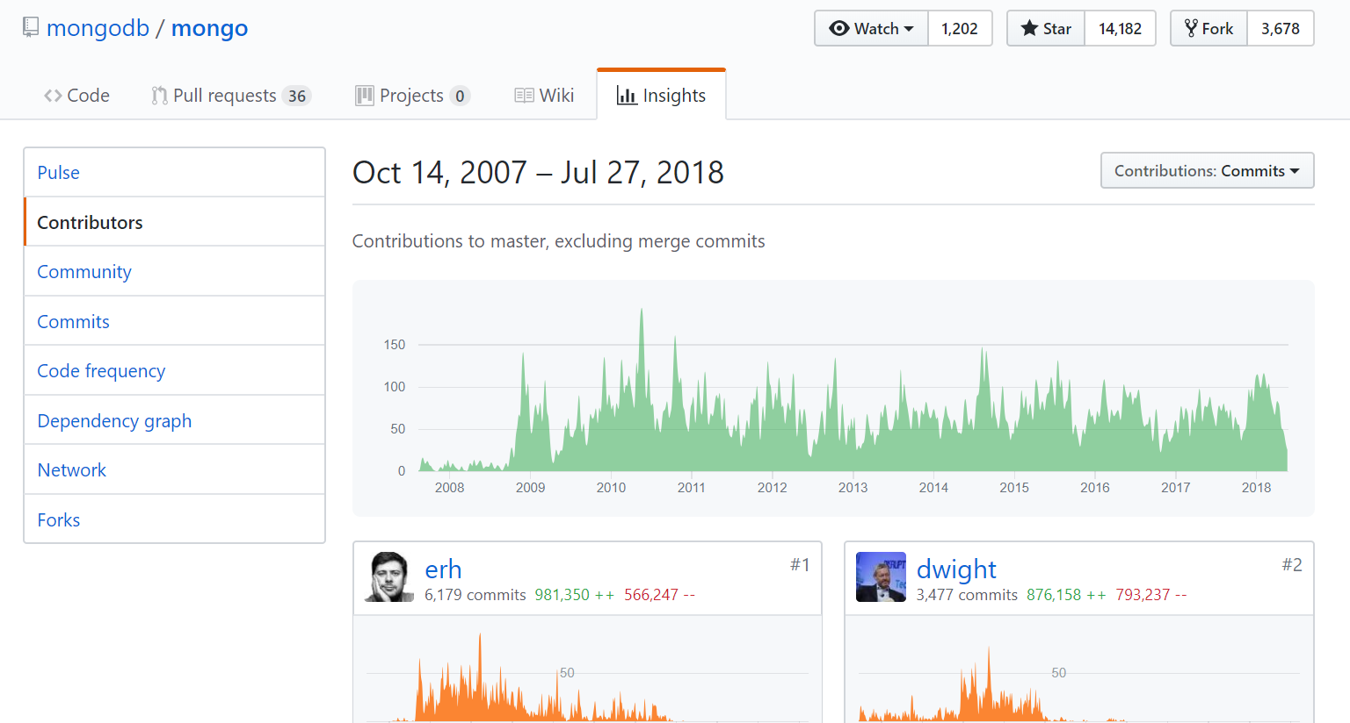
Stability

Slide 25
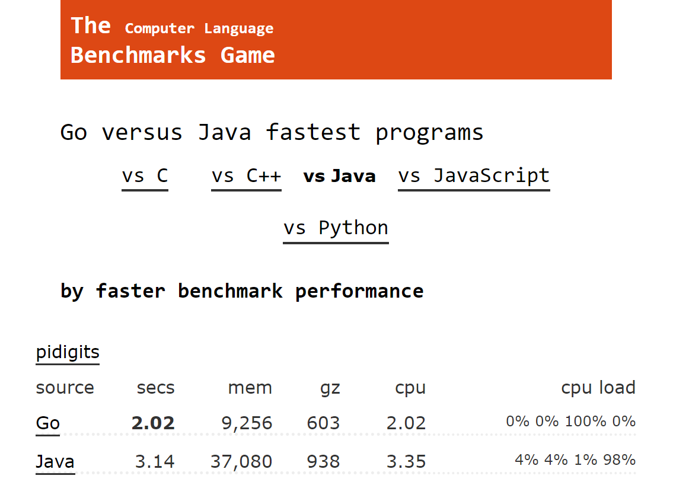
Performance

Slide 26
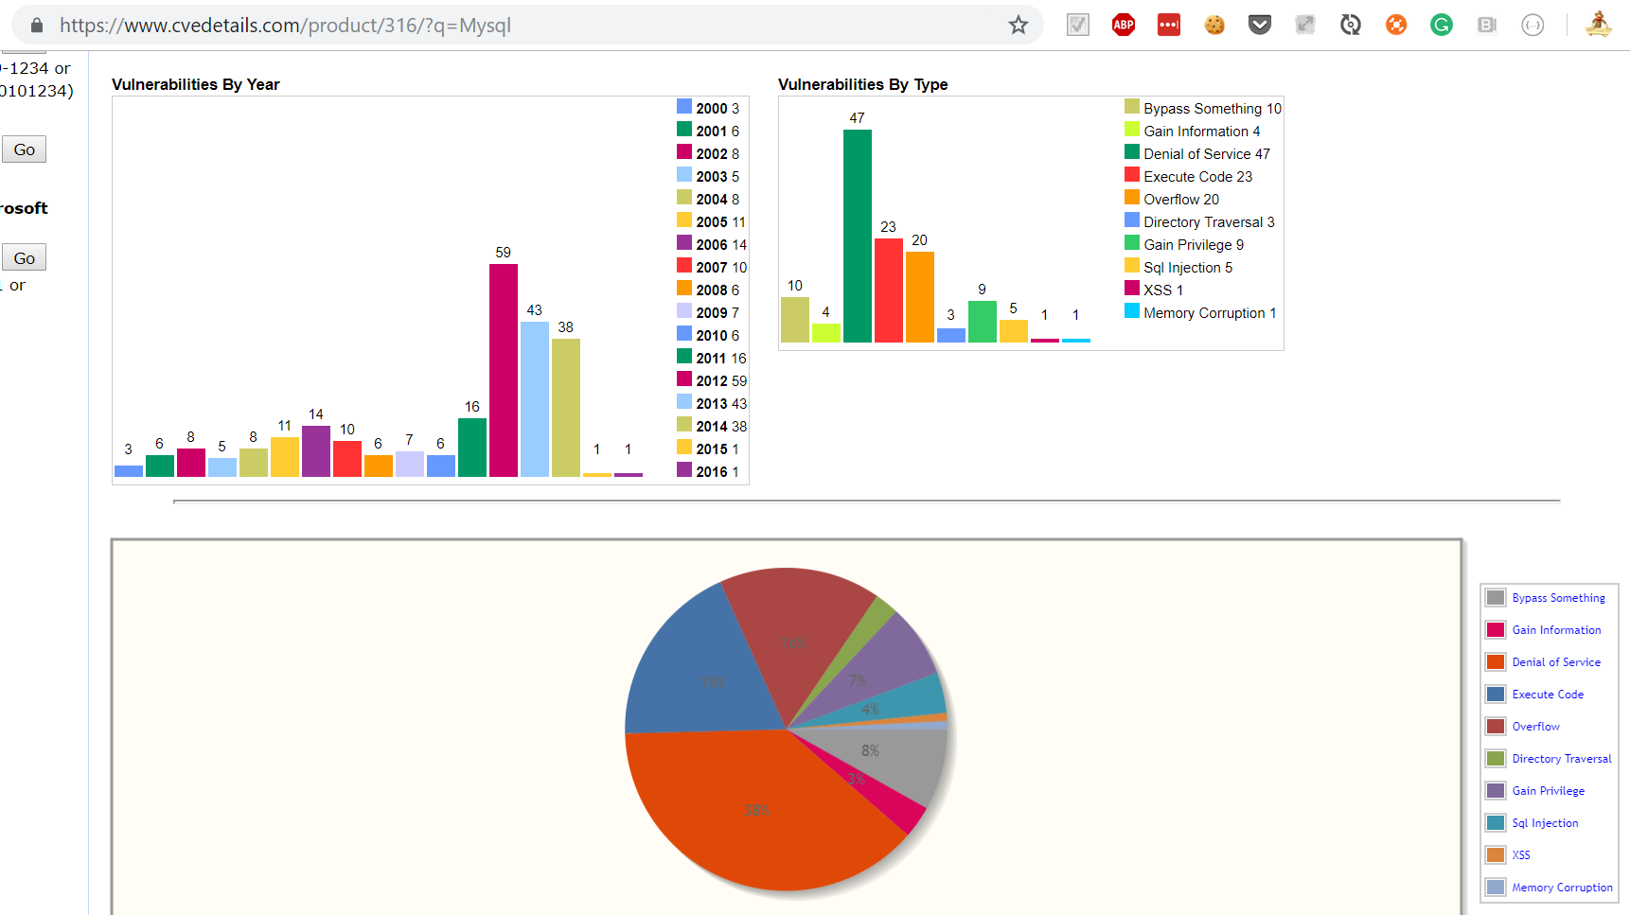
Security

Slide 27
… but this is about HOW
Notes:
POLL!!!

Slide 28
How do you make technical decisions? (32)
I'm using past project experiences - 63%
I'm using framework defaults - 9%
It's a well defined process - 3%
It's totally ad-hoc - 3%
It's architect / tech-lead 's call - 13%
"Stackoverflow it" and just include it in my PR - 3%
other (prefer not to tell) - 6%

Slide 29
Breadth-First

Slide 30
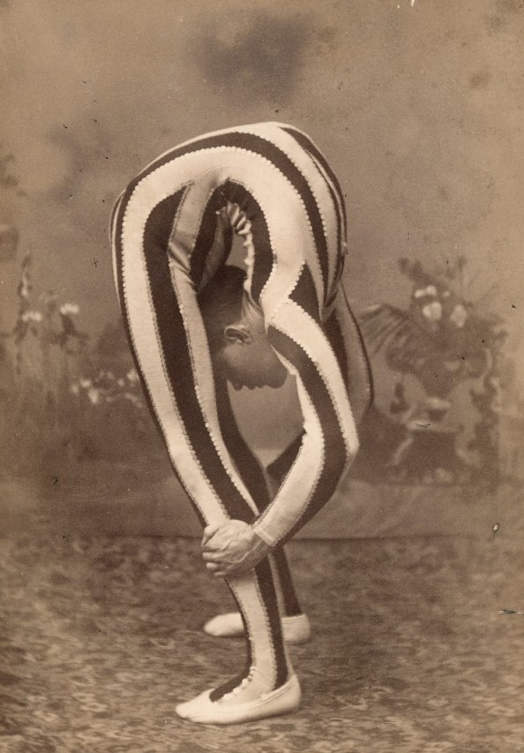
LEAN

Slide 31
LEAN
SET-BASED DESIGN
LAST RESPONSIBLE MOMENT
Notes:
Set-based design: “Deliver as fast as possible”
Last responsible moment: “Decide as late as possible”

Slide 32
Set-Based Design
Get me the …. (fastest, cheapest, easiest)
Branch
Combine

Slide 33
Set-Based Design
CHEAPEST
FASTEST
!
EASIEST
Notes:
Get me the …. (fastest, cheapest, easiest)
Branch
Combine
TODO: 1:30
OWN STORY: Workaround & Parallel in the last day of sprint.

Slide 34
Last Responsible Moment
parallel dependencies
interfaces & abstractions
feature toggles
deprecation
Notes:
OWN STORY: 3 DB implementation. Remove deprecated.
DevOps => sync up for solution. OPS side difficult / easy on DEV side

Slide 35

MISSING KEY INGREDIENT

Slide 36



Slide 37
Decision Making
Work as a team!
Use your intuition wisely
Remember: breadth-first
Be CALM & COLLABORATIVE
Notes:
OWN STORY: 3 DB implementation. Remove deprecated.
TODO: 2:00

Slide 38

Awesome Decision Making Recipe
Get away from computers
Pick 4-7 metrics
Brainstorm alternatives
Collect measures
Rate from 1-5
Disagreement LEAN
Notes:
TODO: 3:30

Slide 39

$$Σ$$
in

Slide 40
HOW
>
WHAT
IT’S NOT TECHNICAL

Slide 41

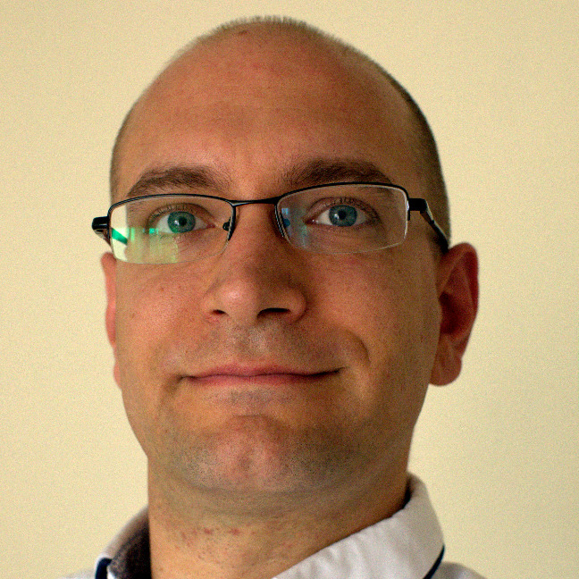




Thank you!
Oresztész Margaritisz
@gitaroktato
gitaroktato
gitaroktato
https://www.linkedin.com/in/oresztesz
Kraków, 9-11 May 2018

Slide 42
Q & A

Slide 43

Thank You!
Oresztész Margaritisz
@gitaroktato
gitaroktato
gitaroktato
https://www.linkedin.com/in/oresztesz

Slide 44
References
How we decide (book summary)
Choose Boring Technology
Set-based design
How to make technical decisions given very little time?
Stackoverflow Insights
CVE Details
Analyzing code with SonarQube in Docker
Google Trends
Software Engineering Wisdom
Lean Tools: Making Decisions
Lean Tools: Options Thinking
Emotional Intelligence

